Slide 1
Justice Systems and Accountability:
Some Reflections
Dr Jerome Joseph
Professor (Retd.)
IIM Ahmedabad (Oct 1986-March 31, 2015)

Slide 2
Max Weber’s Social Action Typology
Affectual
Traditional
Means-ends rational action
Value Rational

Slide 3
Max Weber’s Typology of Rationality
Practical: every way of life that views and judges worldly activity in relation to the individual's purely pragmatic and egoistic interests as practical rational
Theoretical: involves a conscious mastery of reality through the construction of increasingly precise abstract concepts rather than through concrete action
Formal: Whereas practical rationality always indicates a diffuse tendency to calculate and to solve routine problems by means-end rational patterns of action in reference to pragmatic self interests; formal rationality ultimately legitimates a similar means-end rational calculation by reference back to universally applied rules, laws, or regulations.
Substantive: Like practical rationality though unlike theoretical rationality, substantive rationality directly orders action into patterns. It does so, however, not on the basis of a purely means-end calculation of solutions to routine problems but in relation to a past, present, or potential "value postulate”. substantive rationality is considered to be a "valid canon"; that is, a unique "standard" against which reality's flow of unending empirical events may be selected, measured, and judged

Slide 4
Max Weber and Rationality Valence
Practical rationality is founded on means-end pursuit of interests and this type of instrumental rationality reacts to changing situations in an opportunistic manner
Theoretical rationality is a cognitive process of trying to understand reality by searching for interrelationships with limited scope for achieving direct change of that reality
Formal rationality deals with random situations through abstract rules and laws
Only action based on Substantive rationality can “introduce a methodical way of life” to moderate interests based practical rationality and rules based formal rationality. Ethical substantive rationality as per Weber is “a specific type of value-rational belief among individuals, which, as a consequence of this belief, imposes a normative element on human action.” When an ethical rationality penetrates practical rational action, Weber refers to that action as “practical-ethical”

Slide 5
Alternative Perspectives and Expressions
The Hierarchical-Control-Coercive Perspective
“Other” Managed
The Empowered-Collegial-Consensus Perspective
“Self” Managed
Accountability
Responsibility

Slide 6
The Collegial Accountability Anthem
Where The Mind Is Without Fear..
From the Gitanjali By Rabindranath Tagore
Where the mind is without fear
and the head is held high
Where knowledge is free
Where the world has not been broken up into fragments by narrow domestic walls
Where words come out from the depth of truth
Where tireless striving stretches its arms towards perfection
Where the clear stream of reason has not lost its wayinto the dreary desert sand of dead habit
Where the mind is led forward by thee into ever-widening thought and action
Into that heaven of freedom, my Father, let my country awake

Slide 7
 | Functional Accountability | Institutional Accountability
Role Accountability | 1 Role-Function Accountability | 2 Person-Institution Accountability
Personal Accountability | 3 Person-Function Accountability | 4 Role-Institution Accountability

Slide 8
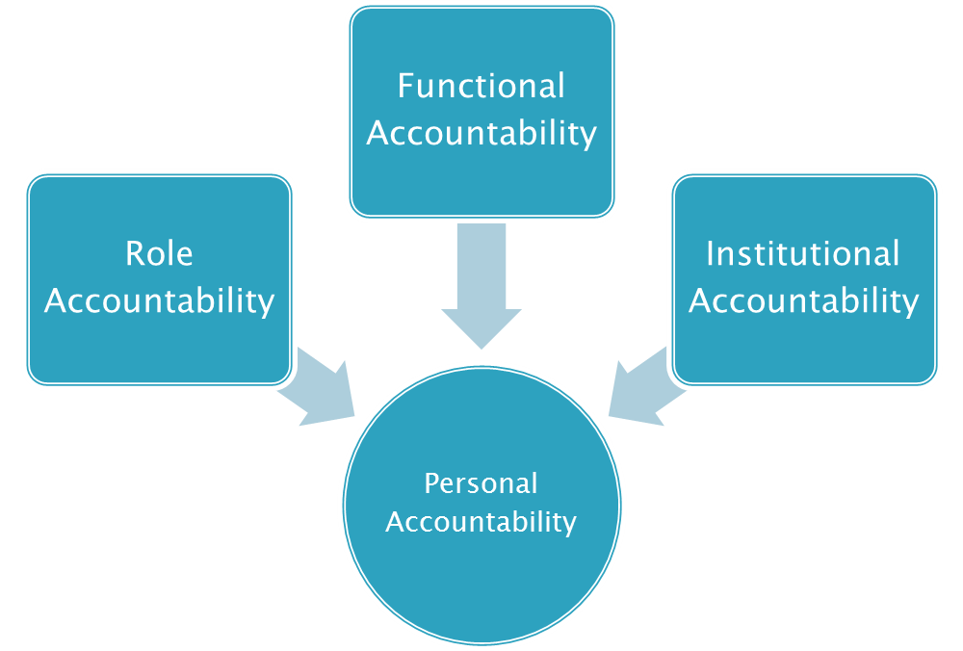

Slide 9
The Collegial Accountability Anthem
Where The Mind Is Without Fear..
From the Gitanjali By Rabindranath Tagore
Where the mind is without fear
and the head is held high
Where knowledge is free
Where the world has not been broken up into fragments
by narrow domestic walls
Where words come out from the depth of truth
Where tireless striving stretches its arms towards perfection
Where the clear stream of reason has not lost its way
into the dreary desert sand of dead habit
Where the mind is led forward by thee into ever-widening thought and action
Into that heaven of freedom, my Father, let my country awake.
The Fearlessness Quotient
The Respect Quotient
The Knowledge Quotient
The Impartiality Quotient
The Integrity Quotient
The Solutions Quotient
The Discernment Quotient
The Interpretative Quotient
The Independence Quotient
Poetic Imagination
Accountability Insights

Slide 10
 | Institutional Accountability
Personal Accountability | Person-Institution Accountability The Fearlessness Quotient The Respect Quotient The Knowledge Quotient The Impartiality Quotient The Integrity Quotient The Solutions Quotient The Discernment Quotient The Interpretative Quotient The Independence Quotient

Slide 11
 | Functional Accountability
 | Role-Function Accountability
Role Accountability | Efficiency Analytical Ability Professional Integrity Organized Working Communication Effectiveness | Effectiveness Thirst for Requisite knowledge Performance Resilience Professional Enthusiasm Synthesizing Capacity
 | Enabling Transformative contribution Progressive Orientation Intellectual Agility Mutuality Orientation | Enhancing Decisive Independence: Holistic Perspective Strategic Capability Creative Ability

Slide 12
 | Functional Accountability
Personal Accountability | Person-Function Accountability Expectations Actions Knowledge Competency Effort Motivation Compassion Innovation Integrity Collegiality

Slide 13
 | Institutional Accountability
Role Accountability | Role-Institution Accountability Competency Development Contribution Assessment Culture Building Compensation Management Communication

Slide 14
 | Functional Accountability |  | Institutional Accountability
 | Role-Function Accountability |  | Role-Institution Accountability
Role Accountability | Efficiency Analytical Ability Professional Integrity Organized Working Communication Effectiveness | Effectiveness Thirst for Requisite knowledge Performance Resilience Professional Enthusiasm Synthesizing Capacity | Competency Contribution Culture Compensation Communication
 | Enabling Transformative contribution Progressive Orientation Intellectual Agility Mutuality Orientation | Enhancing Decisive Independence: Holistic Perspective Strategic Capability Creative Ability
 | Person-Function Accountability |  | Person-Institution Accountability
Personal Accountability | Expectations Actions Knowledge Competency Effort Motivation Compassion Innovation Integrity Collegiality |  | The Fearlessness Quotient The Respect Quotient The Knowledge Quotient The Impartiality Quotient The Integrity Quotient The Solutions Quotient The Discernment Quotient The Interpretative Quotient The Independence Quotient

Slide 15
 | Functional Accountability | Institutional Accountability
Role Accountability | The Fearlessness Quotient The Respect Quotient The Knowledge Quotient The Impartiality Quotient The Integrity Quotient The Solutions Quotient The Discernment Quotient The Interpretative Quotient The Independence Quotient | The Fearlessness Quotient The Respect Quotient The Knowledge Quotient The Impartiality Quotient The Integrity Quotient The Solutions Quotient The Discernment Quotient The Interpretative Quotient The Independence Quotient
Personal Accountability | The Fearlessness Quotient The Respect Quotient The Knowledge Quotient The Impartiality Quotient The Integrity Quotient The Solutions Quotient The Discernment Quotient The Interpretative Quotient The Independence Quotient | The Fearlessness Quotient The Respect Quotient The Knowledge Quotient The Impartiality Quotient The Integrity Quotient The Solutions Quotient The Discernment Quotient The Interpretative Quotient The Independence Quotient

Slide 16
The Fearlessness Quotient
The Knowledge Quotient
The Interpretative Quotient
The Independence Quotient
The Impartiality Quotient
The Integrity Quotient
The Respect Quotient
The Solutions Quotient
The Discernment Quotient

Slide 17
http://www.legallyindia.com/images/kianganz/image_3c33a06d445b8372c4024199549a2eea.png

Slide 18
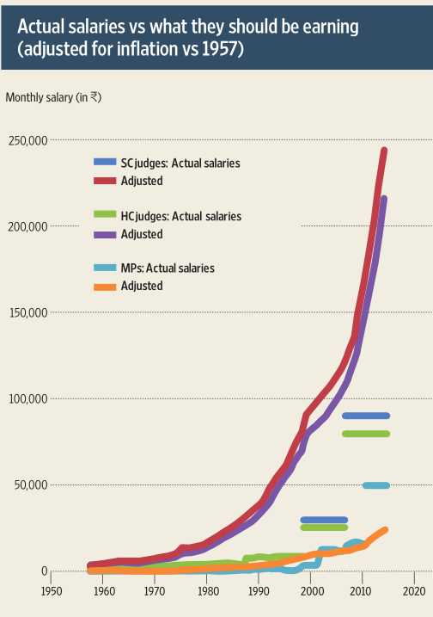

Slide 19
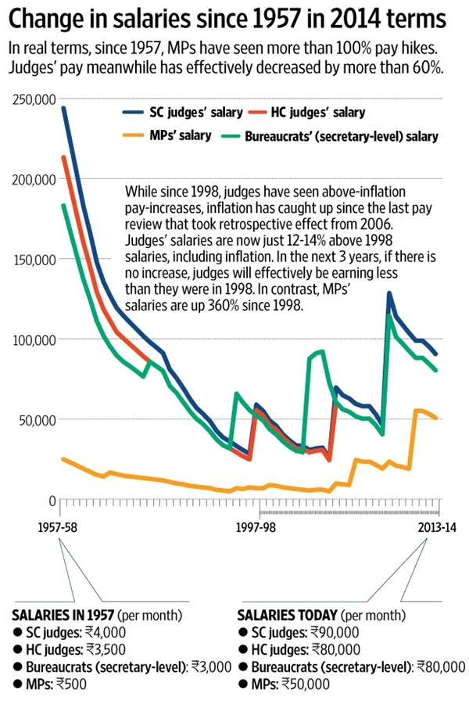

Slide 20
